Slide 1
SSH Persistence
Lateral Movement - T1021.004

Slide 2
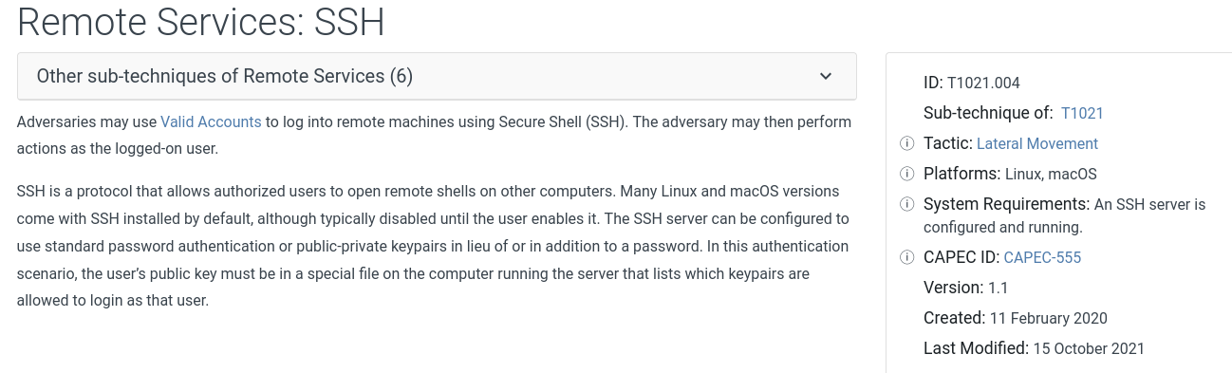
MITRE ATT&CK

Slide 3
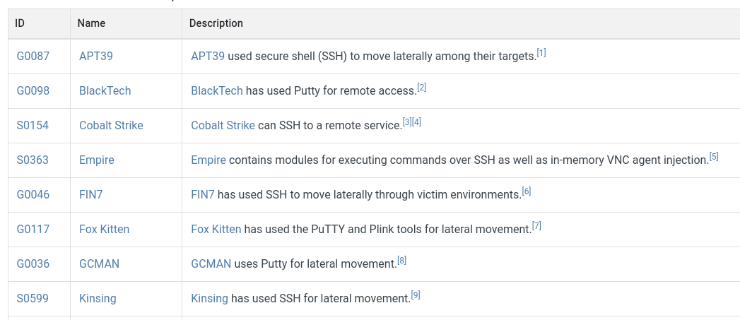
MITRE ATT&CK - Adversary Information

Slide 4
Summary of Actions
Actions to Take
Gather the MFA Secret Code from Webshell Access
Setup OTP in Google Authenticator
Authenticate as admin account (use provided ssh public key)
Use access for recon - Setup SSH tunnel if necessary…
Setup SSH Tunnel for python3 http.server
Setup SSH Tunnel for python3 reverse shell

Slide 5
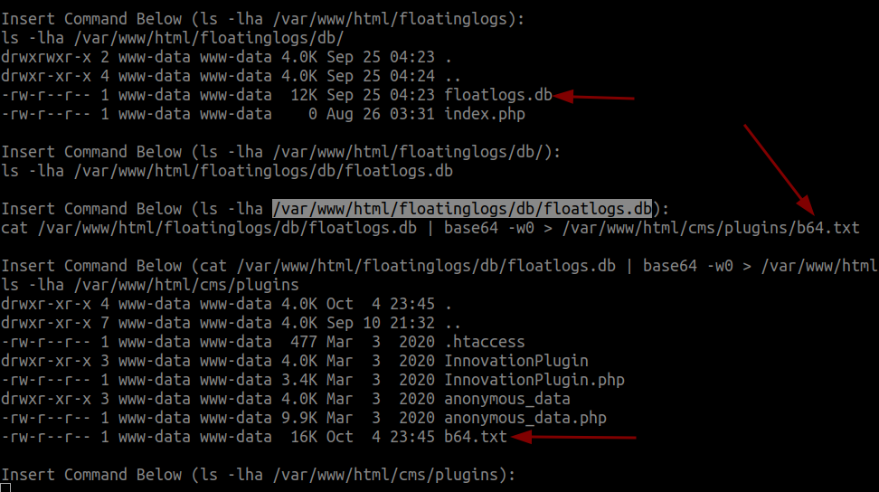
Exfil Database
Find the floatlogs.db
Base64 and more to a directory accessible, could be in the original directory
Then access by the URL to exfiltrate the file

Slide 6
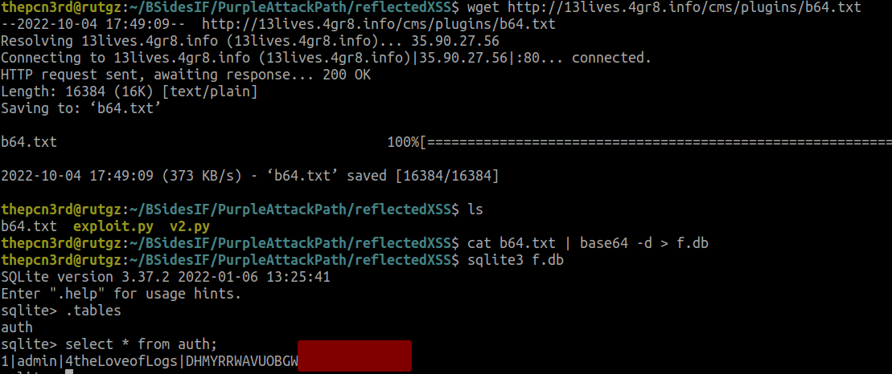
Look at the Database
Download the b64.txt file
Decode the b64.txt to the sqlite3 database file
Use sqlite3 to access the database
.tables - Lists the tables
select * from auth to list the contents of the auth table

Slide 7
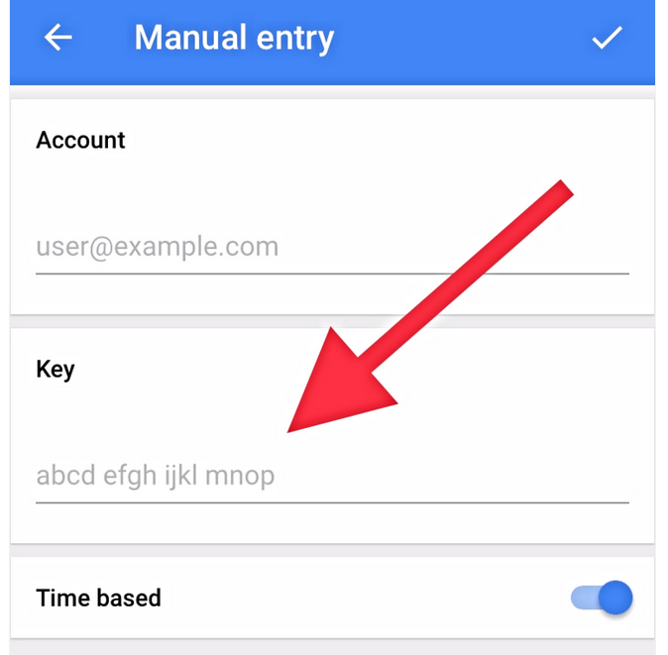
Add Secret Code to Google Authenticator
Open Google Authenticator, click the +, and Enter a setup key
Input the Alpha-Numeric key output from the table (with the red square covering the last section) as the setup key
This will provide you with the OTP code to be able to sign-in as the admin account

Slide 8
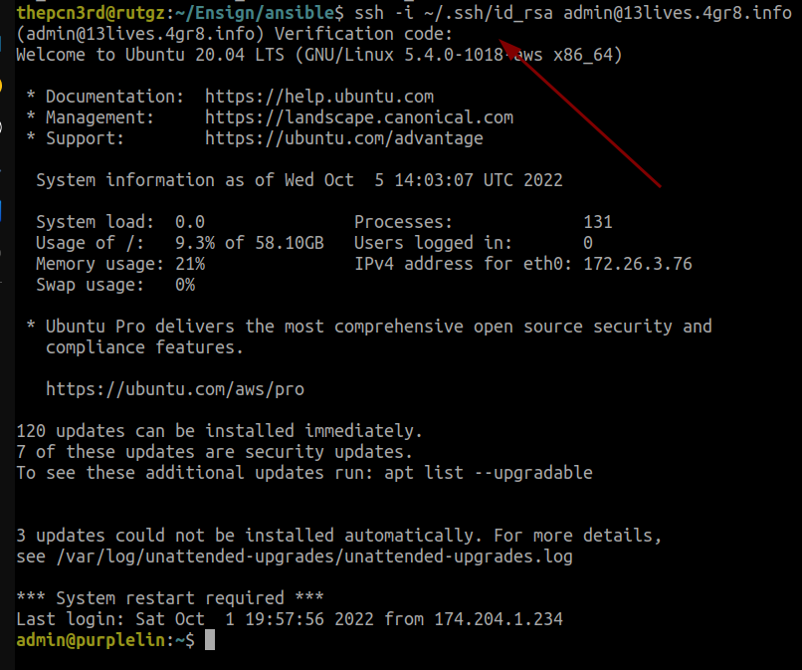
Authenticate with SSH
Use the provided SSH key to authenticate to admin@13lives.4gr8.info
The verification code is what appears as the OTP in Google Authenticator
Please be nice to the lab environment you are provided!!

Slide 9
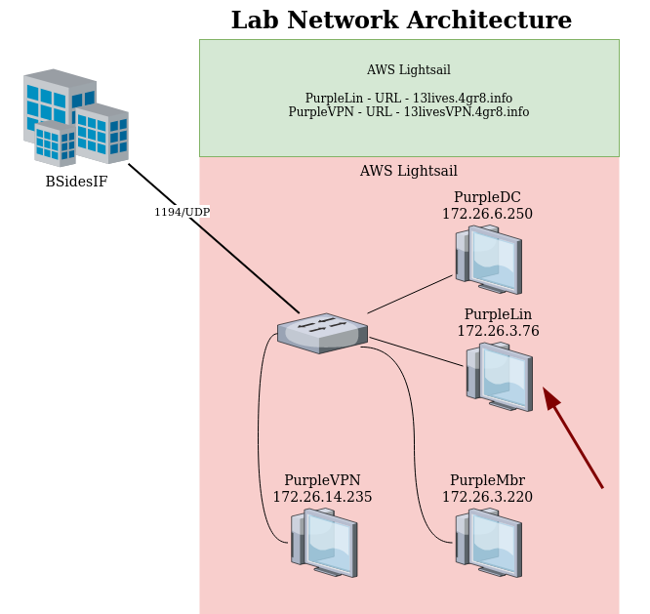
Recon - Network Diagram for Lab
Note: The lab environment may change and I will update the IP Addresses in the workshop if necessary
From this location we can run a variety of tools for recon. Please do not run any tools like responder or anything that interferes with the broadcast traffic.
Move your focus to PurpleMbr. This is setup as a workstation where noprat.c authenticates and checks his email.

Slide 10
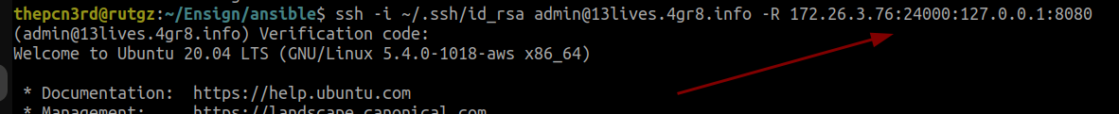
SSH Reverse Tunnel for http.server
If we send a phishing email with a macro to execute and download a payload, we do not have a location to store it on the internet.
We could store the payload on this linux server and setup a python web server to allow it, however being conscious of dropping our tools on the box we can host it locally and through the reverse tunnel allow access.
Note: I selected port 24000 because that is the port I am using in my macro for execution. I also specified the IP Address of the PurpleLin server because it needs to listen on its private IP Address for the connection from PurpleMbr

Slide 11
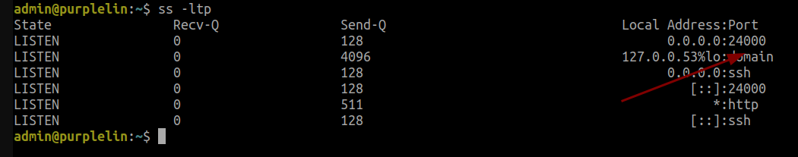
Verify Reverse SSH Tunnel is Active
The server should be listening on port 24000 as shown above or the port that you chose!
Note: This is a lab environment, we will have to use different ports for your respective connections!!!

Slide 12
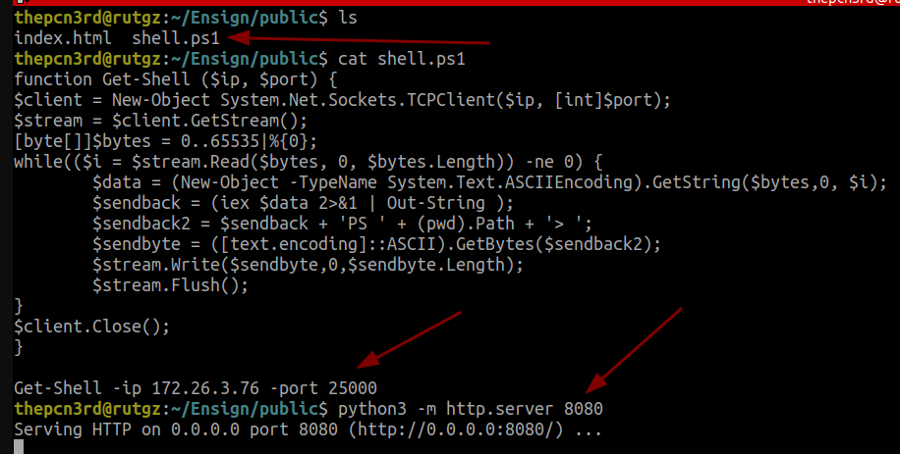
Start http.server on host with SSH Tunnel
Create a folder called public or something where anything in that folder can be accessible through the http.server
Placed a powershell reverse shell in that folder
Executed the python3 module specifying that it listen on port 8080
The connection through the tunnel will pull the shell.ps1 file in our macro

Slide 13
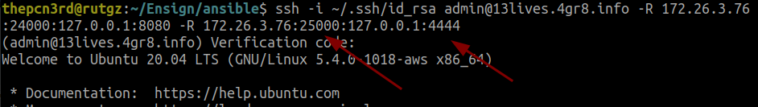
Setup Reverse Tunnel for Reverse Shell
Modify the initial SSH command to include the reverse tunnel for port 25000 to port 4444 on my local computer. (Port 25000 will not be available for everyone)
This will allow the reverse shell from PurpleMbr to connect through the tunnel through the PurpleLin and then to a nc listener on your local computer/device.

